Slide 1
Data Qualities Tool
Andrew West
2021-10-28 13:56
https://el2-prd-connect.azure.defra.cloud/content/14/
https://github.com/Defra-Data-Science-Centre-of-Excellence/MS2_DataQuality/

Slide 2
On Data Quality
Data Qualities are an automated kind of metadata.
They are metrics gathered from reading the data.
Use them to understand a dataset better, and judging the suitability when:
Picking out a dataset to use.
Writing a data quality report.
Pointing out caveats in results.
This dashboard is also useful for:
Finding what data we have available.
Precalculated results so you don’t have to read large dataset.
This is particularly useful for geospatial data.
We have; crs, gtypes, validities, npoints, bbox*, area*.
*not yet

Slide 3
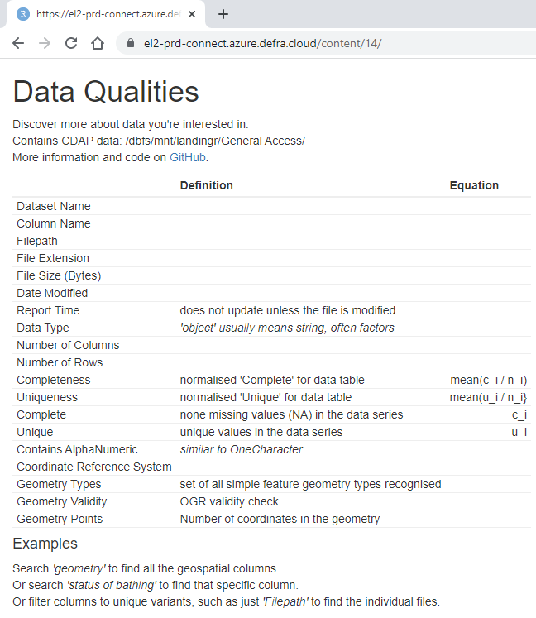
No promises of beauty!
Nor promises that it is explained well. But I will try, please suggest improvements!
The data catalogue exists for metadata, descriptions, and audit information, sorry I won’t have those metrics.
It works by crawling through CDAP data, reading known data types using pandas, and calculating metrics. Available on GitHub:
https://github.com/Defra-Data-Science-Centre-of-Excellence/MS2_DataQuality/

Slide 4
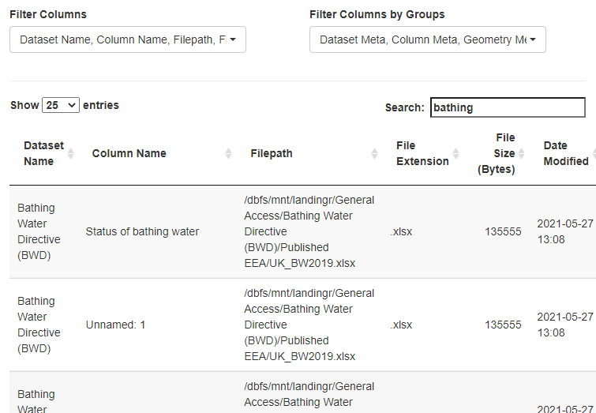
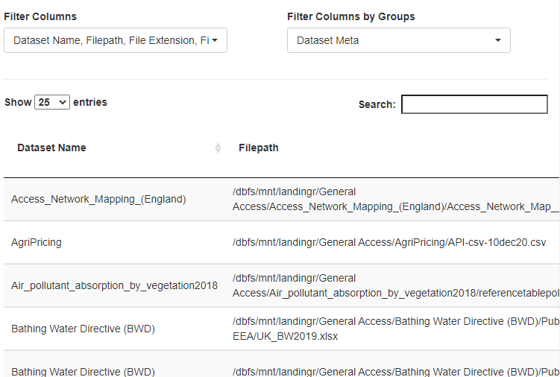
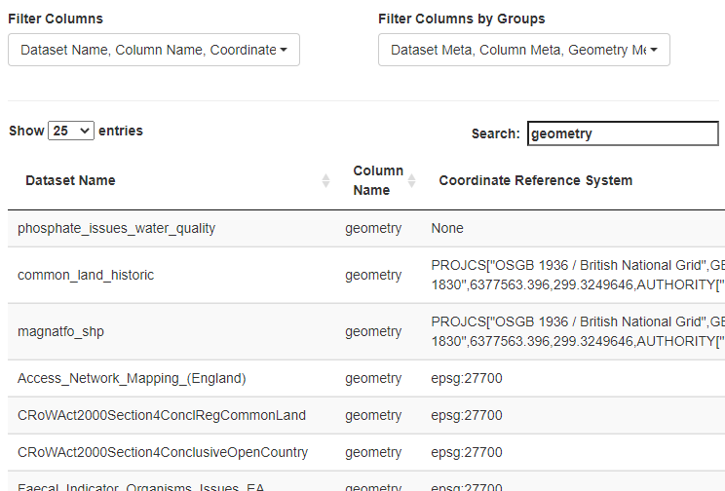
Filter or Search
Search
Filter Columns
*this also applies a unique to the table
Order
Combine a filter, search, and order by CRS to find geometries that don’t use British National Grid (they actually do!)

Slide 5
Access
Go to link: https://el2-prd-connect.azure.defra.cloud/content/14/
Login with Email and MS password
Hopefully it is that easy!
Any problems I can temporarily make it open access.

Slide 6
Questions
Andrew West
2021-10-28 13:56
https://el2-prd-connect.azure.defra.cloud/content/14/
https://github.com/Defra-Data-Science-Centre-of-Excellence/MS2_DataQuality/

